Slide 1

Wisconsin Union
FY25 Segregated Fee Budget
October 26th, 2023

Slide 2
Overview of Budget
Summary
2.35% increase in Operating Budget Portion of Segregated Fees
  FY24 $15,079,660 → FY25 $15,433,337, increase of $353,677
  FY24 $165.36 → FY25 $169.24 on a per student basis assuming constant enrollment
Equal Decrease in Debt Service Portion of Segregated Fees
  FY24 $8,529,470 → FY25 $8,175,793, decrease of $353,677
  FY24 $85.68 → FY25 $81.80
Total Segregated Fee: $251.04 = 169.24 + 81.80

Slide 3
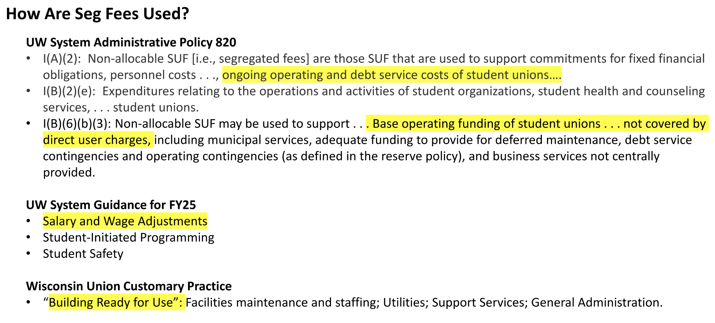
High Level Budget Overview

Slide 4
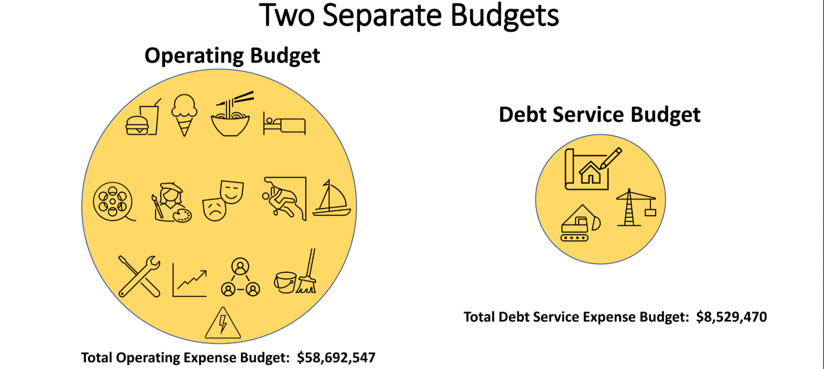
High Level Budget Overview

Slide 5
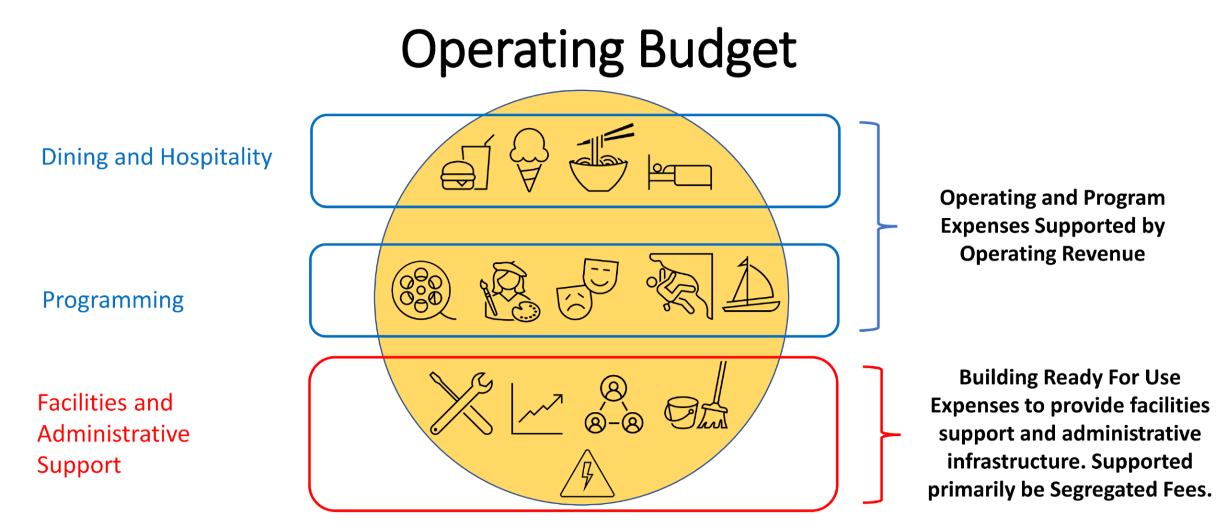
High Level Budget Overview

Slide 6
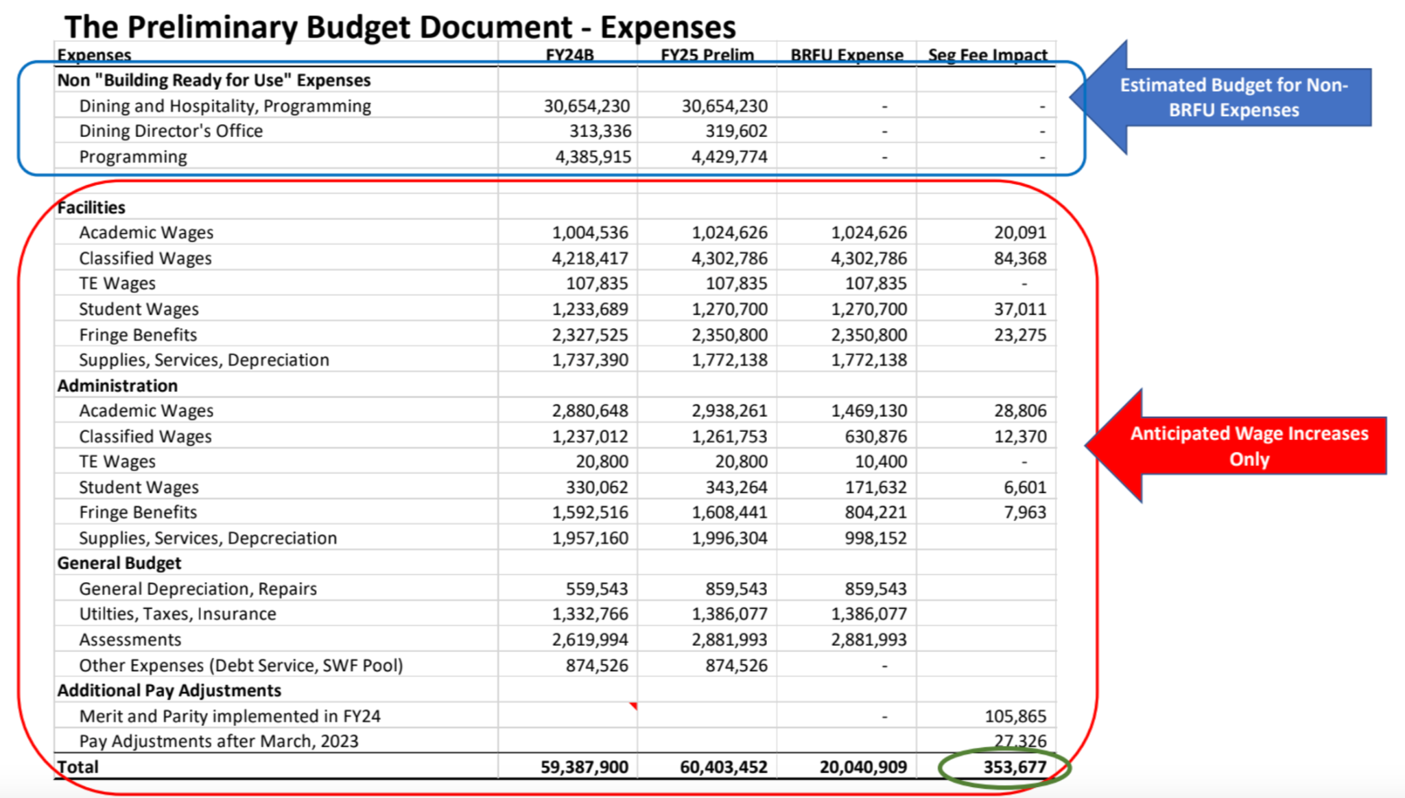
Breakout of Operating Budget

Slide 7
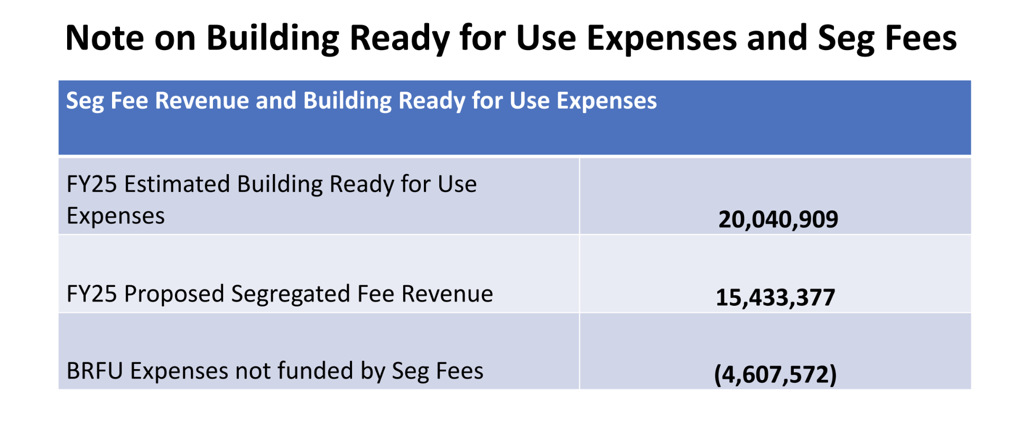
What Seg Fees Will Cover

