Slide 1

Officer Position Stats
February 28, 2024

Slide 2

Agenda
Introduction
Resources
Social media strategy + best practices
Director spotlight post

Slide 3
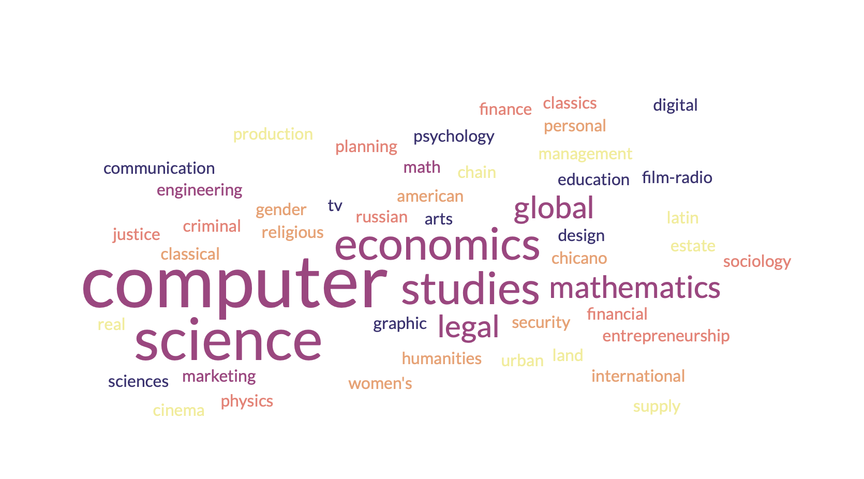

Slide 4

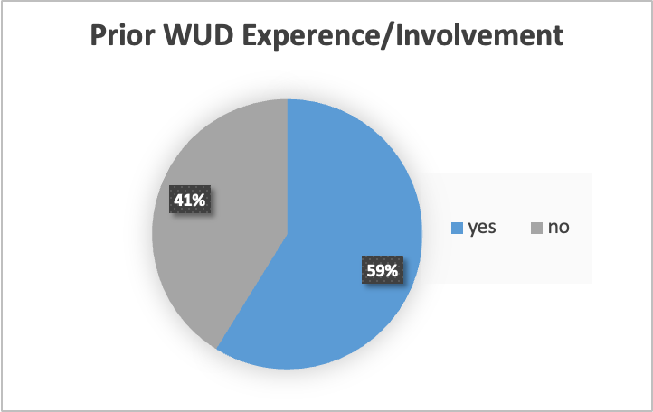

Slide 5

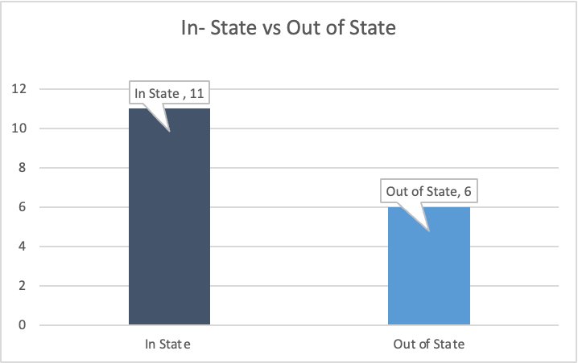
Notes:
How things went
attendance tracking
what could have went better
Rose bud thorn
Either big events or general events
What went well, what could be improved overall mkt

Slide 6

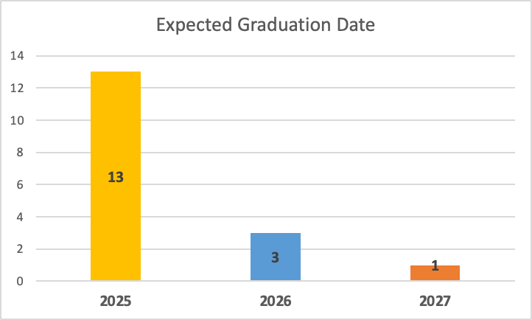
Notes:
Word of mouth
Advertising on own
Will have a campaign and general big push
Everything getting released when come back from break
All campus email going out first week we get back

Slide 7
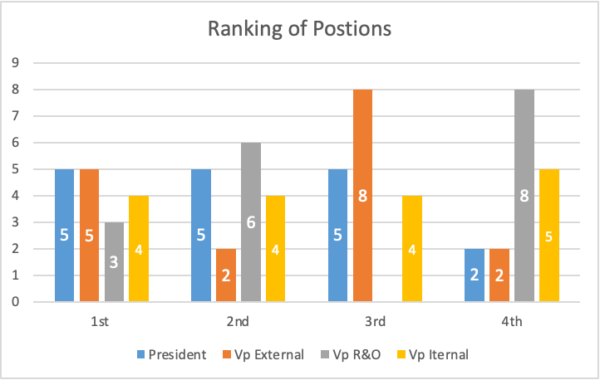

Slide 8
Thank you!

