Slide 1
Student Activity Center Request Tutorial
How To Make An Online Reservation

Slide 2
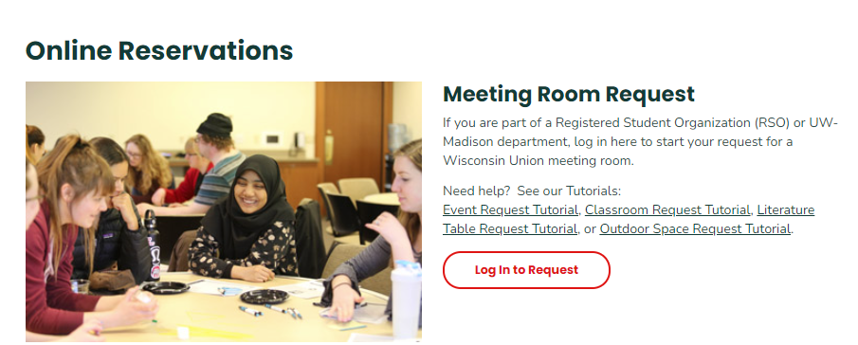
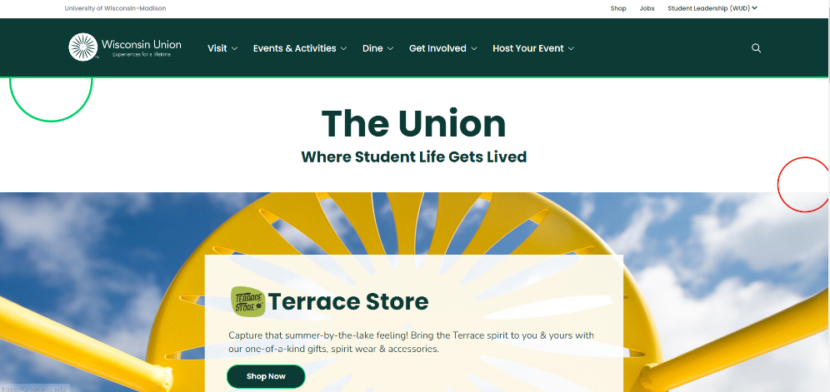
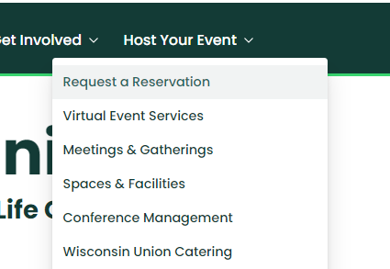
Where to find SAC Room Requests
Step 1:
Go to the Union website found at https://union.wisc.edu/
Step 4:
On the Request a Reservation Page, the SAC request form will be found under “Meeting Room Request”. Please select “Log In to Request” to start the reservation.
Step 2:
At the top of the page, hover your mouse over the “Host Your Event” tab.
Step 3:
Select the “Request a Reservation” option.

Slide 3
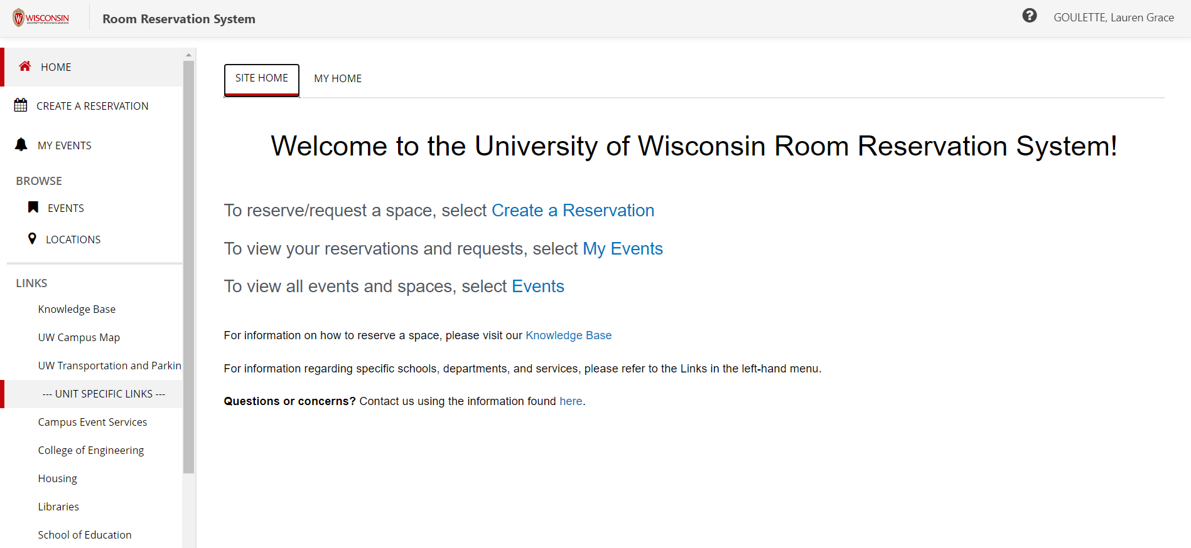
EMS: Online Reservation System
EMS Home Page:
At the bottom of the EMS home page will be information on starting your reservation request.
This information includes:
  Our office times and contact information
  The proper template you will need for your reservation
  Additional AV and equipment pricing

Slide 4
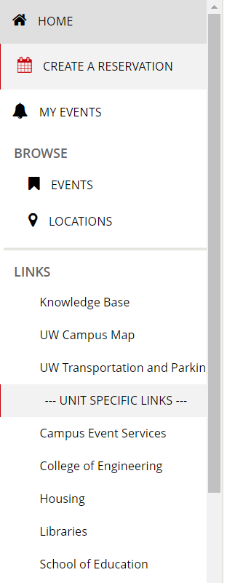
EMS: Online Reservation System
EMS Functions:
Under “Home” on the left side of the page are a number of other EMS
functions.
  Selecting “Create a Reservation” will bring you to the template page for your event
  Selecting “My Event” will bring you to a list of reservations you have made through EMS.
  Information, such as event status and reservation numbers can also be found on this page.
  Selecting “Events” will bring you to the full list of events happening in the Wisconsin Union buildings, campus classrooms, the Student Activity Center (SAC), or outdoor spaces.
    This list is also known as the “T.I.T.U.,” or “Today in the Union.”

Slide 5
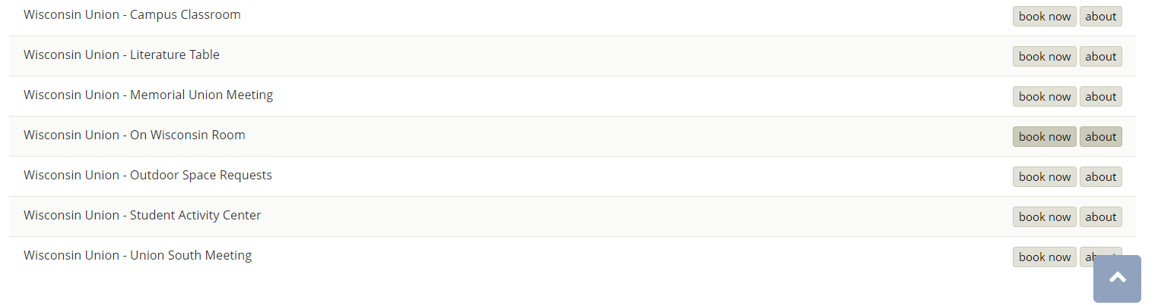
Creating Your Reservation: SAC
Step 1: Select the correct reservation template
The “Campus Classroom Request” template will be used for education buildings, such as Humanities or Computer Sciences
The “Wisconsin Union Meeting Room Request” will be used for meeting spaces between Memorial Union and Union South
The “Student Activity Center Meeting Room” is for rooms on the 3rd and 4th floor of the SAC in East Campus Mall

Slide 6
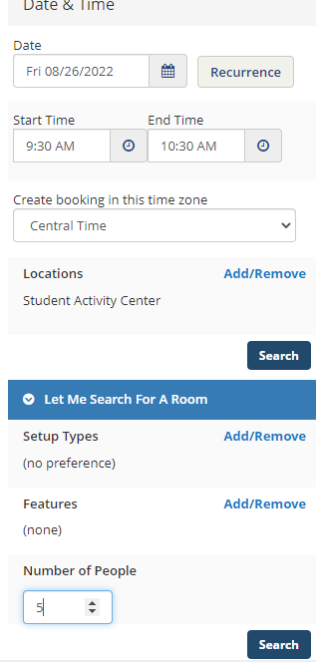
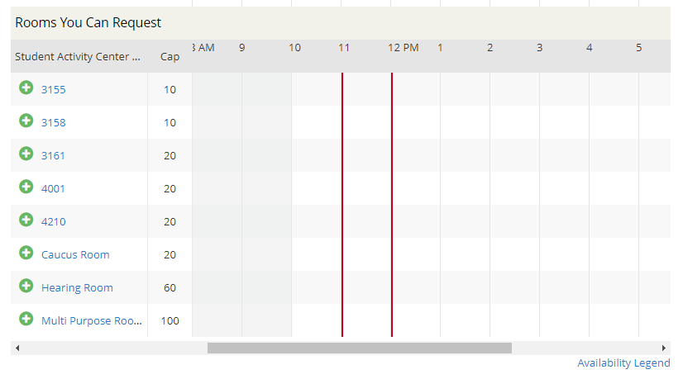
Creating Your Reservation: SAC
Step 2: Add Date and Time Information
Select recurrence if you have multiple dates for the semester to reserve
Step 3: Add how many people will be attending the event
Tip: If you cannot see the “Number of People” counter, please click the drop-down arrow on the “Let Me Search for a Room” tab. A room will not populate if this is not filled out.
Step 4: Hit “Search”
Step 5: After hitting search, the list of rooms will populate. Choose the green plus sign next to whichever room you want your event to be in.
Please note that specific rooms will not populate if your guest count is over the room’s capacity

Slide 7
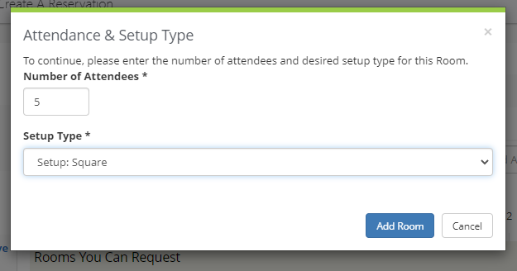
Creating Your Reservation: SAC
Step 6: Once you select the green plus sign, this pop-up will appear. Now you can choose what setup for the event you would like.
Step 7: Click the “Add Room” button after you choose your setup type.
Step 8: The pop-up will disappear and you can click “Next Step” in the right corner.

Slide 8
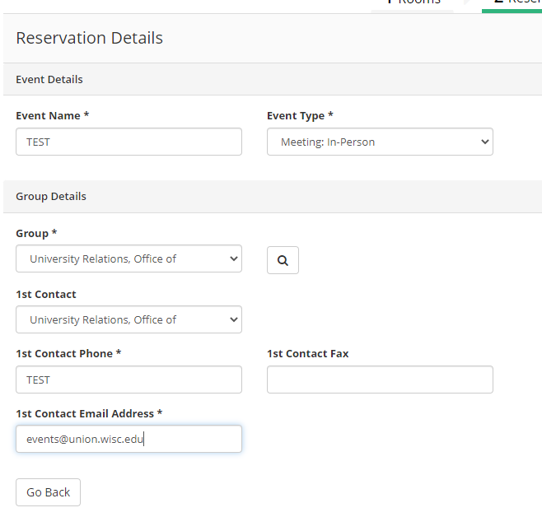
Creating Your Reservation: SAC
Step 9: Fill out the name of the event and what type of event it is
Step 10: Select the group or department your group is with by hitting the magnifying glass to the right of the “Group*” bar
Please enter in your RSO or department name that ends with "WU".
This step can be tricky, but there is a way to make it easy. If you search “%” with a keyword from your group name following it, all options for that keyword will appear.
Step 11: Fill in the contact information
If your name is not listed in the contacts, choose “temporary contact” and insert your name in the “1st Contact Name*”

Slide 9
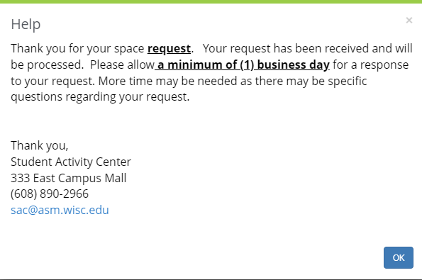
Creating Your Reservation: SAC
Step 12: Click the “Create a Reservation” button on the bottom right side of the page. This pop-up will appear after. Select “OK” after and your event has been created!

